Slide 1
CompSci – Data Structures

Slide 2
Outline
Project Check-In
Computer Science Context
Big O Notation
Data Structures
Arrays
Stacks / Queues
Linked Lists
Dictionaries
Hash Tables
Sets
Binary Trees and Binary Search Trees
Graphs
Notes:
<number>

Slide 3
Project Check-In
Notes:
<number>

Slide 4

Project Status?
Smoooooth Sailing?
Notes:
<number>

Slide 5
Computer Science Context
Notes:
<number>

Slide 6

Welcome To…
“Computer Science Fundamentals”
Notes:
<number>

Slide 7
Remember…
Computer Science “Fundamentals”
Isn’t about “easy” computer science stuff.
Rather, it’s about the “fundamental” concepts that underlie all of the work we’ve been doing to date.
The biggest takeaway is to understand that there are different tools to increase computational efficiency.
Notes:
<number>

Slide 8
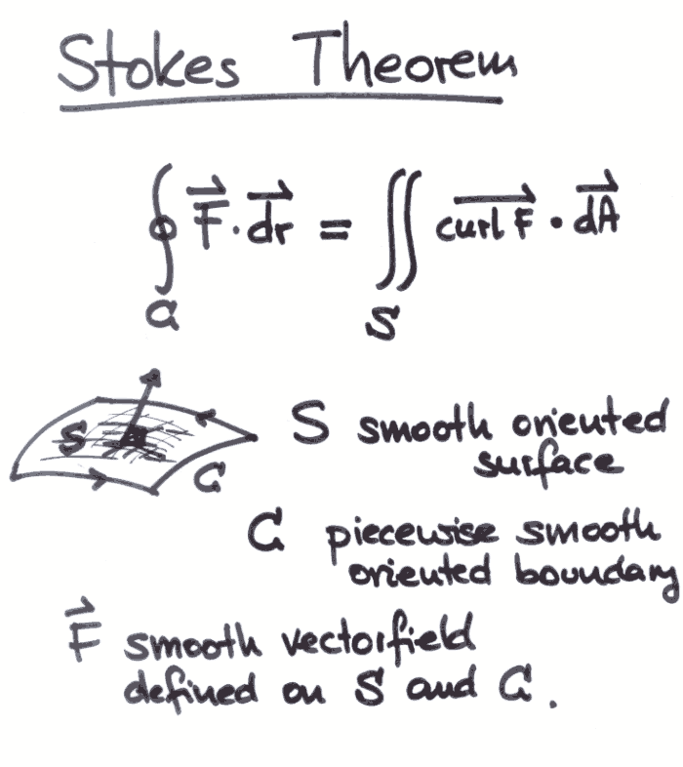
“Fundamentals”
Remember this stuff?
Yeah. Me neither.
Notes:
<number>

Slide 9
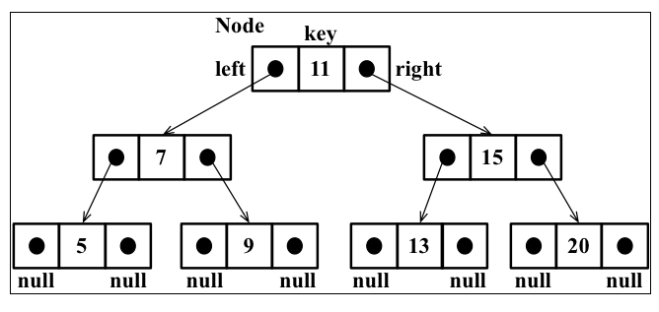
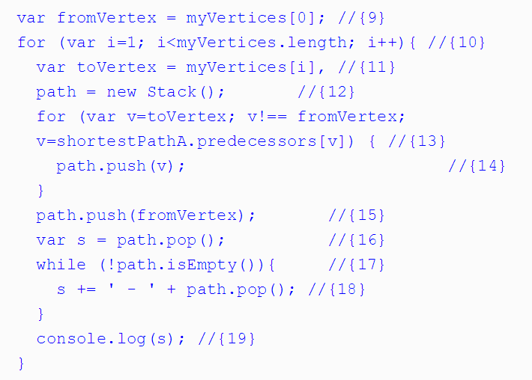
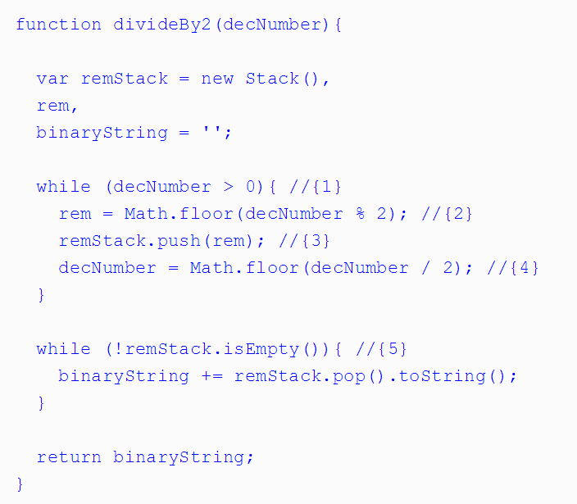
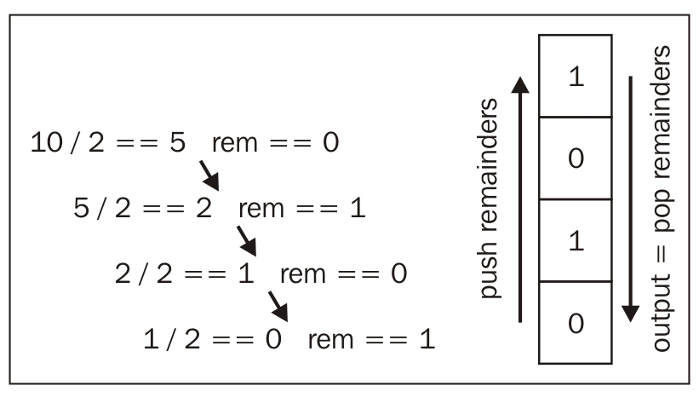
It gets hairy… and scary.
Notes:
<number>

Slide 10

Be Wary of Imposter Syndrome!
Don’t let the hard stuff scare you…
Notes:
<number>

Slide 11
Why Cover This?
These concepts sometimes appear in coding interviews
When inheriting large code-bases you may be tasked to “optimize” code efficiency.
The computational challenges here forces you to deepen your understanding.
Notes:
<number>

Slide 12
Bottom Line
My goal is to give you the terminology and the concepts.
Enough insight that you can understand the context of interview questions that come your way.
And… to encourage those of you into math to take a second look.
Notes:
<number>

Slide 13
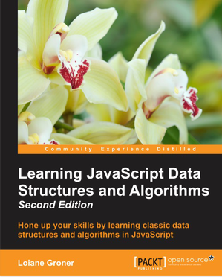
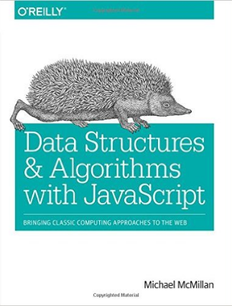
Going Deep
For those that dare dive deeper.
Notes:
<number>

Slide 14
Efficiency
Notes:
<number>

Slide 15
What does “efficient” mean?
We talk a lot about “efficiency”.
Notes:
<number>

Slide 16
What does “efficient” mean?
But…
Notes:
<number>

Slide 17
What does “efficient” mean?
What, exactly, does “efficient” mean?
Notes:
<number>

Slide 18
Fewer Steps = Faster Code
Number of steps ~ Efficiency
Notes:
<number>

Slide 19
Fewer Steps = Faster Code
More steps = Less Efficient
Fewer Steps = More Efficient
Notes:
<number>

Slide 20
What’s a “step”?
A step is an instruction to the computer.
All computations boil down to a handful of “basic steps”.
Arithmetic (+, *, etc.)
Assignment (var x = 42;)
Boolean tests (x === 42)
Reading from memory
Writing from memory
Notes:
<number>

Slide 21
What’s a “step”?
Each of these counts as a step.
Notes:
<number>

Slide 22
What’s a “step”?
Fewer Steps = Faster Code
Notes:
<number>

Slide 23
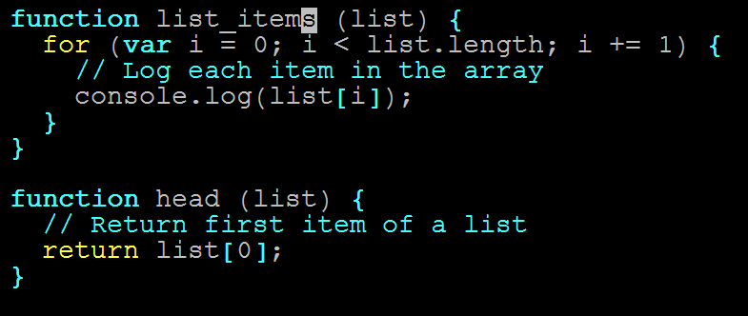
Pop Quiz (!)
Which function is more efficient?
(Which has fewer instructions?)
Notes:
<number>

Slide 24
Count Instructions
Count the instructions!
Notes:
<number>

Slide 25
Count Instructions
head = 1 instruction
Notes:
<number>

Slide 26
Count Instructions
list_items = n instructions
…
(n = list.length)
Notes:
<number>

Slide 27
The Verdict
head is more efficient.
Notes:
<number>

Slide 28
The Verdict
But list_names isn’t bad…
Notes:
<number>

Slide 29
Time Complexity
Notes:
<number>

Slide 30
Quantifying Efficiency
head always executes one instruction…
Notes:
<number>

Slide 31
Quantifying Efficiency
…No matter how long our array is
Notes:
<number>

Slide 32
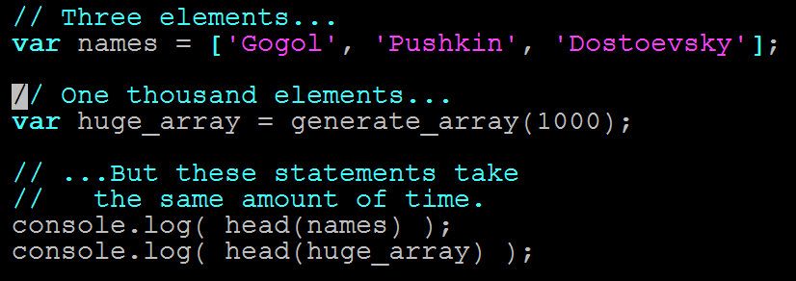
Quantifying Efficiency
head takes same amount of time on any input
Notes:
<number>

Slide 33
Quantifying Efficiency
list_items needs n instructions
Notes:
<number>

Slide 34
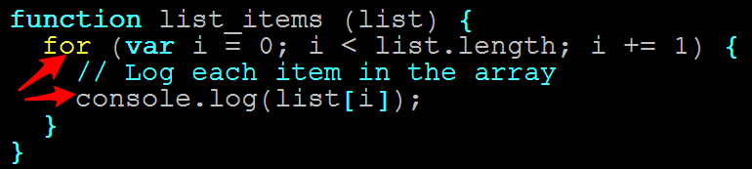
Quantifying Efficiency
One console.log per item
Notes:
<number>

Slide 35
Quantifying Efficiency
console.log is fast…
Notes:
<number>

Slide 36
Quantifying Efficiency
…but not free.
Notes:
<number>

Slide 37
Quantifying Efficiency
Longer arrays = more time
Notes:
<number>

Slide 38
Quantifying Efficiency
Double array length = Double time
Triple array length = Triple time
Notes:
<number>

Slide 39
Quantifying Efficiency
In other words…
Notes:
<number>

Slide 40
Quantifying Efficiency
The running time of head and list_items scale differently.
Notes:
<number>

Slide 41
Quantifying Efficiency
Time complexity = Rate at which algorithm slows as input grows
Notes:
<number>

Slide 42
Quantifying Efficiency
head is always one instruction
Notes:
<number>

Slide 43
Quantifying Efficiency
Running time does not slow for larger inputs
Notes:
<number>

Slide 44
Quantifying Efficiency
In other words…
Notes:
<number>

Slide 45
Quantifying Efficiency
The running time of head is constant.
Notes:
<number>

Slide 46
Quantifying Efficiency
list_items takes n instructions
Notes:
<number>

Slide 47
Quantifying Efficiency
Running time depends on array
Notes:
<number>

Slide 48
Quantifying Efficiency
Double array length, double time
Etc…
Notes:
<number>

Slide 49
Quantifying Efficiency
Running time increase linearly with array length.
Notes:
<number>

Slide 50
Big O Notation
Notes:
<number>

Slide 51
Big O
Big O notation lets us describe how running time scales when we increase the input size (n)
Denoted with a big O, and the “growth factor” in parentheses
Examples:
head ~ O(1)
Grows like “1”—i.e., running time never grows
list_items ~ O(n)
Grows like “n”—i.e., gets bigger as n gets bigger
Notes:
<number>

Slide 52
Big O
There are other Big O “classes”
Notes:
<number>

Slide 53
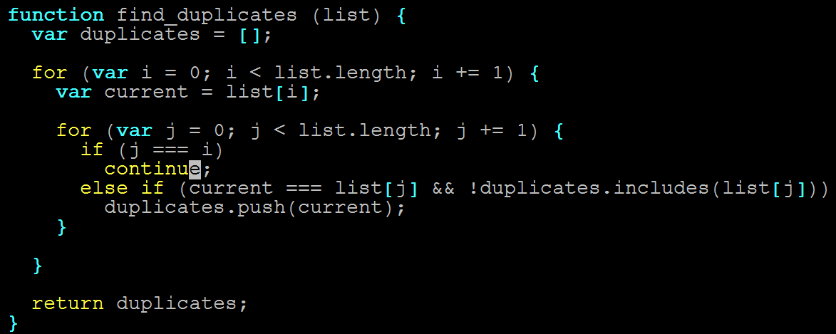
Big O
n steps for each of the n items in list (!)
Notes:
<number>

Slide 54
Big O
2x length = 4x time
3x length = 9x time
nx length = n² time
Notes:
<number>

Slide 55
Big O
Running time grows as square of input
Notes:
<number>

Slide 56
Big O
find_duplicates ~ O(n²)
“Quadratic time complexity”
Notes:
<number>

Slide 57
Big O
MAJOR INSIGHT
Notes:
<number>

Slide 58
Big O
2 nested for loops ~ O(n²)
Notes:
<number>

Slide 59
Big O
NOT COINCIDENCE!
Notes:
<number>

Slide 60
Big O
3 nested for loops ~ O(n³)
Etc.
Notes:
<number>

Slide 61
Big O
One more…
Notes:
<number>

Slide 62
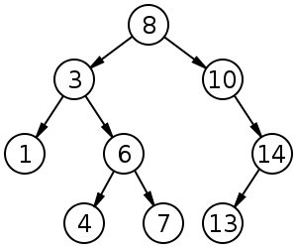
Big O
How fast is binary search?
Notes:
<number>

Slide 63
Big O
Is it…
O(1)
O(n)
O(n²⁾
Something else?...
Notes:
<number>

Slide 64
Big O
Something else.
Why?
Notes:
<number>

Slide 65
Exercise
Binary search this array by hand, for 3, then 9.
Count the steps.
Notes:
<number>

Slide 66
Big O
3 steps.
Notes:
<number>

Slide 67
Big O
Add the digits 11-20. Repeat.
Notes:
<number>

Slide 68
Big O
4 steps (!)
Notes:
<number>

Slide 69
Big O
Much faster than linear.
Notes:
<number>

Slide 70
Big O
(input size)² ~ 2x running time
(input size)³ ~ 3x running time
^{Etc.}
Notes:
<number>

Slide 71
Big O
This is called O(lg n).
Notes:
<number>

Slide 72
Big O
lg n = how many times do I divide n by two to get to 1?
Notes:
<number>

Slide 73
Logarithm Example
What is lg 8?
Notes:
<number>

Slide 74
Logarithm Example
8 / 2 = 4 (1)
4 / 2 = 2 (2)
2 / 2 = 1 (3)
Notes:
<number>

Slide 75
Logarithm Example
lg 8 = 3
^{But if this is confusing…}
Notes:
<number>

Slide 76
Logarithm Example
Don’t worry about it.
Notes:
<number>

Slide 77
Big O Review
head ~ O(1)
Grows like “1”—i.e., 2x input size -> 1x running time
list_items ~ O(n)
Grows like “n”—i.e., 2x input size -> 2x running time
find_duplicates ~ O(n²)
Grows like “n^{2”}—i.e., 2x input size -> 4x running time
binary_search ~ O(lg n)
Grows like “lg n”—i.e, (input size)² -> 2x running time
Notes:
<number>

Slide 78
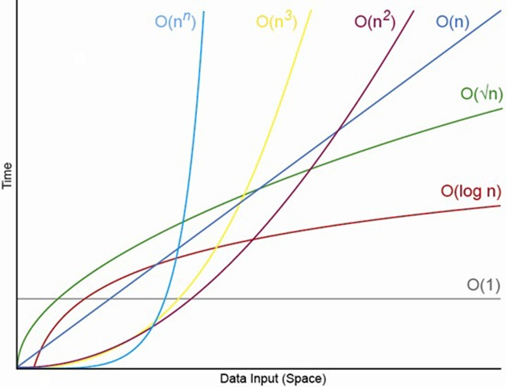
Big O Comparisons

Slide 79
Data Structures
Notes:
<number>

Slide 80
Data Structures? (Tricky Question)
What is a data structure?
(And what is an example?)
Notes:
<number>

Slide 81
Data Structures? (Tricky Question)
Before we answer that…
Notes:
<number>

Slide 82

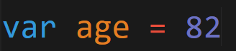
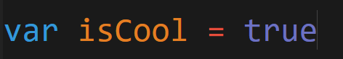
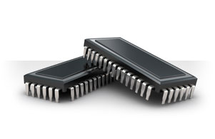
Code = Data. Data is Saved.
Code we write…
Gets saved in memory…
Notes:
<number>

Slide 83
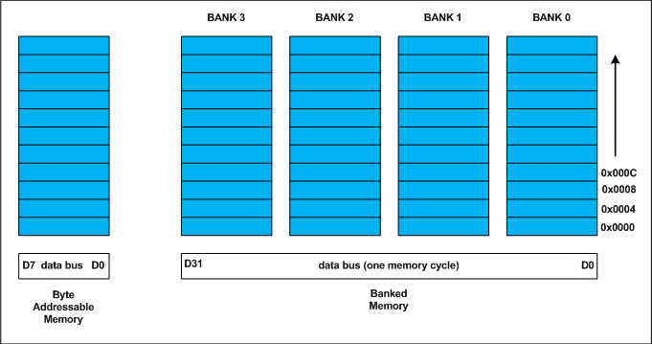
Different Ways to Save…
Memory can be visualized as slots. Data is then allotted into these slots.
Notes:
<number>

Slide 84
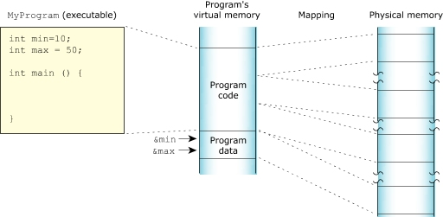
Memory on My Mind
Our code as a whole takes some of these slots of memory.
Our variable data itself also takes slots of memory.
Notes:
<number>

Slide 85
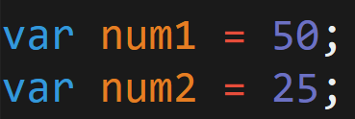
Saving to Memory…
Code
Memory
50
25
Each time we declare or instantiate a variable, we are saving that data to memory.
Notes:
<number>

Slide 86
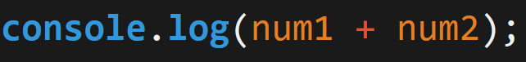
Retrieving from Memory…
Code
Memory
50
25
When we reference these variables in our code, we are retrieving the data from memory.
Notes:
<number>

Slide 87
Growing Data = Growing Problem
As applications grow and we begin to incorporate larger quantities of information with inter-relationships…
These simple operations of saving, retrieving, etc.
Become a lot more intensive (both time-wise and CPU processing wise).
Don’t let the simplicity fool you!
Notes:
<number>

Slide 88


Building Devices
Fitbit Surge
You have 1 MB. Use it wisely
Devices inherently have limited memory because of space requirements – making efficiency decisions critical
Notes:
<number>

Slide 89
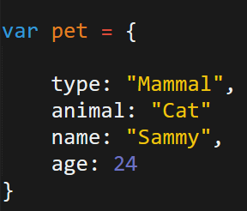
Retrieving from Memory…
Code
Memory
pet
Mammal
type
Cat
animal
Sammy
name
24
age
Even simple objects, require memory to keep track of numerous relationships in memory.
Notes:
<number>

Slide 90
Data Structures?
What is a data structure?
A way of storing data so that it can be used efficiently by the computer or browser.
Notes:
<number>

Slide 91
Data Structures?
What is a data structure?
They are built upon simpler primitive data types (like variables)
Notes:
<number>

Slide 92
Data Structures?
What is a data structure?
They are non-opinionated, in the sense, that they are just responsible for holding the data.
Notes:
<number>

Slide 93
Data Structures?
Example Data Structure:
Arrays
Notes:
<number>

Slide 94
Arrays
Notes:
<number>

Slide 95
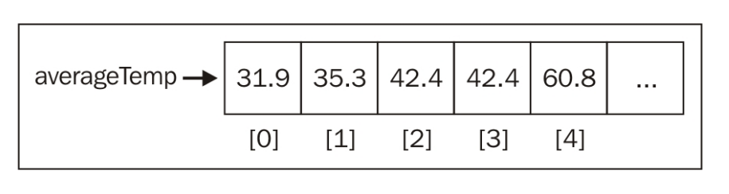
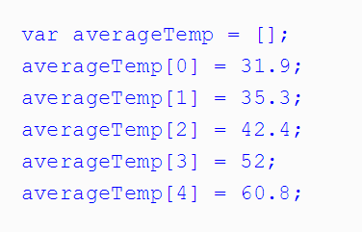
Arrays!
Arrays are the simplest data structure.
Javascript includes it natively.
In most languages, arrays do not allow mixing of types.
In most languages, arrays are not extendable. (They are fixed sizes)
Notes:
<number>

Slide 96
Arrays in Javascript
In most languages (non-Javascript), arrays are immutable – meaning that upon declaration, the length of the array is fixed.
With Javascript, we can easily add elements using the .push method().
Question for You .push adds elements to which side of the array?
Notes:
<number>

Slide 97
Arrays in Javascript
In most languages (non-Javascript), arrays are immutable – meaning that upon declaration, the length of the array is fixed.
With Javascript, we can easily add elements using the .push method().
Question for You .push adds elements to which side of the array?
Notes:
<number>

Slide 98
Arrays in Javascript
2nd Question for You How can we add an element to the beginning of the array?
If you finish early, implement it yourself.
(i.e. Don’t use the in-built method).
Notes:
<number>

Slide 99
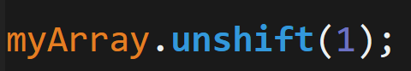
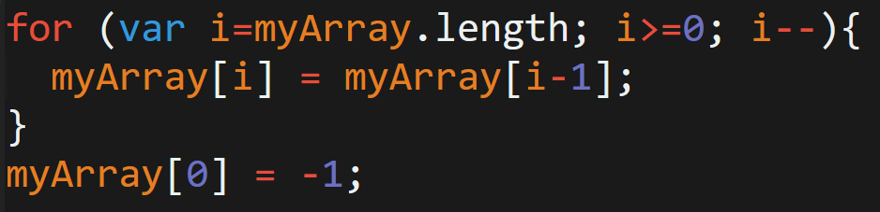
Arrays in Javascript
Unshift Method
What’s really happening…
Notes:
<number>

Slide 100
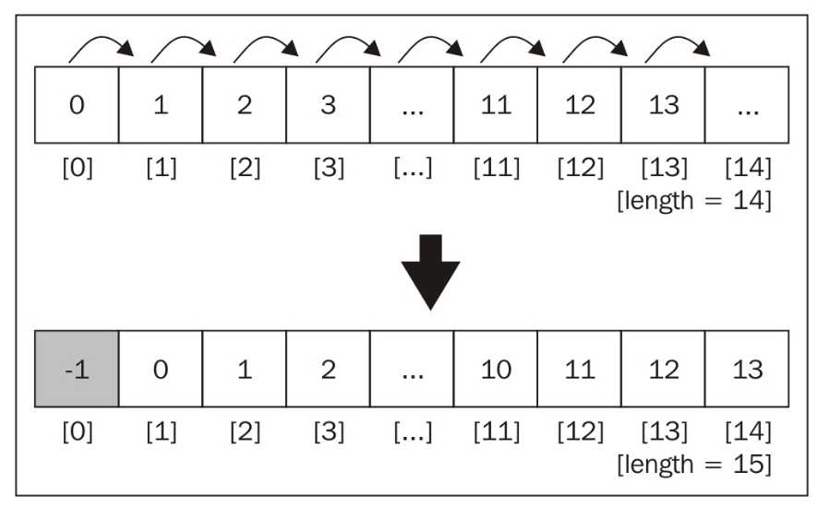
Arrays in Javascript
An inefficiency emerges!
Notes:
<number>

Slide 101
Arrays in Javascript
An inefficiency emerges!
We’ll come back to this.
Notes:
<number>

Slide 102
Stacks / Queues
Notes:
<number>

Slide 103
Data Structures = Abstractions
Going forward, treat each of the following data structures as concepts.
These are paradigmatic ways of organizing data that are commonly seen in code.
Notes:
<number>

Slide 104
Stacks
Stacks are another common data structure.
They are similar to arrays in that they are a sequenced order of numbers.
The difference is they only allow access to the top element.
These data structures obey “LIFO” (Last-in-first-out). This means that new elements are placed at the top and removed from the top.
Stacks are an abstraction for how data can be arranged.
20
14
12
1
Notes:
<number>

Slide 105

Stacks
Stacks are another common data structure.
They are similar to arrays in that they are a sequenced order of numbers.
The difference is they only allow access to the top element.
These data structures obey “LIFO” (Last-in-first-out). This means that new elements are placed at the top and removed from the top.
Stacks are an abstraction for how data can be arranged.
Notes:
<number>

Slide 106
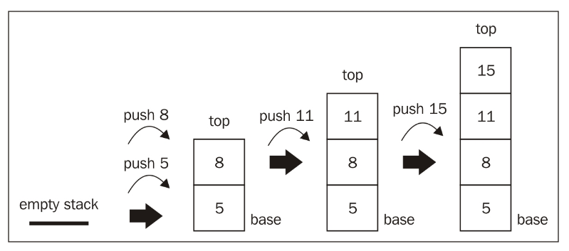
Stacks
Last in First Out:
Items added to the top. Removed from the top
Notes:
<number>

Slide 107
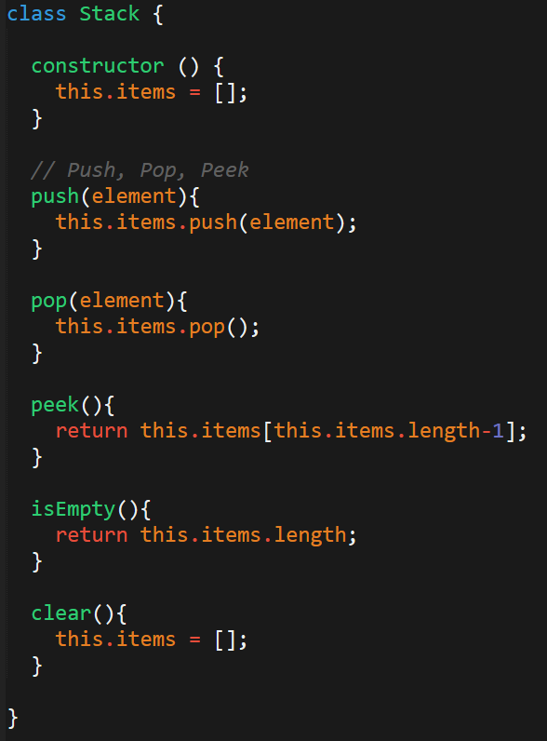
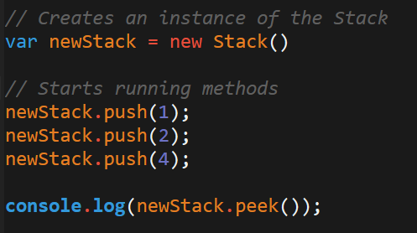
Stacks – In Code
“Stacks” aren’t supported natively in Javascript.
To utilize this structure, one needs to create the class themselves.
Once you’ve created a class you can create and utilize these structures in your code.
Notes:
<number>

Slide 108
Queue
Queues are another common data structure.
They are similar to arrays in that they are a sequenced order of numbers.
The difference is they only allow access to the first element.
These data structures obey “FIFO” (First-in-first-out). This means that new elements are placed at the “back” but that the “first” element is removed from the front.
Queue are an abstraction for how data can be arranged.
20
14
12
1
Notes:
<number>

Slide 109

Queue
Queues are best remembered as similar to a movie queue. The first one in line is the first one to enter (or exit).
Notes:
<number>

Slide 110
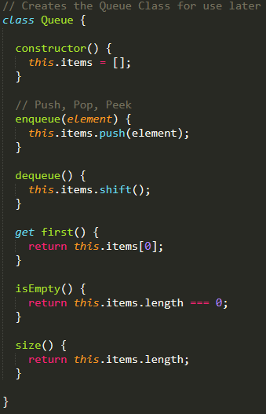
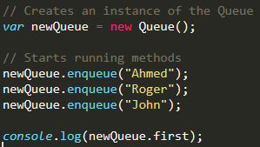
Queue – In Code
“Queues” aren’t supported natively in Javascript.
Again, this means we need to create our own for use.
Queues provide two common methods: enqueue and dequeue.
Notes:
<number>

Slide 111
Linked Lists
Notes:
<number>

Slide 112
Arrays in Javascript
An inefficiency emerges!
We’ll come back to this.
Notes:
<number>

Slide 113
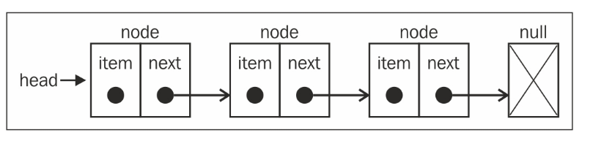
Linked List
Linked Lists are data structures in which each element of the list is sequentially joined to the next element.
The major difference is that the list elements are not stored contiguously in memory (i.e. they fall in different memory slots).
These linked lists keep track of the position of elements using pointers which explicitly point to the “connected item”.
Each element (called nodes) track both the item and the “next item’s” position.
Notes:
<number>

Slide 114

Linked List
Linked Lists are like trains.
Each car of the train not only knows its own position – but it also knows the position of the train in front of it.
Notes:
<number>

Slide 115
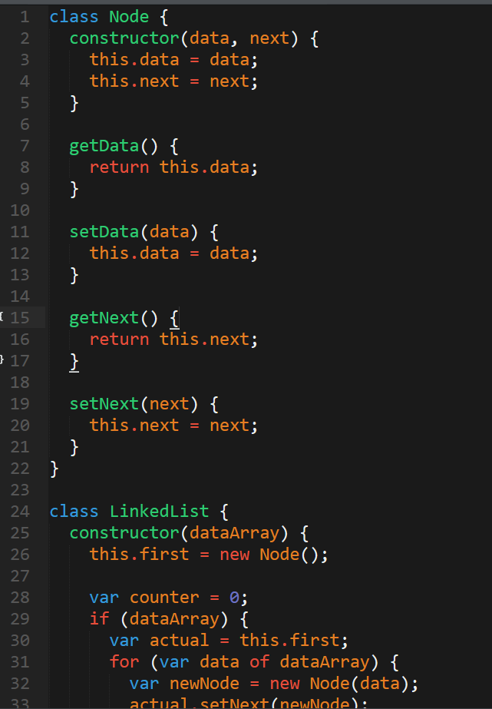
Linked List – In Code
JS does not include Linked Lists natively
But when you need one…
Plenty of implementations are available online.
http://codepen.io/gben/pen/ZGLava
Notes:
<number>

Slide 116
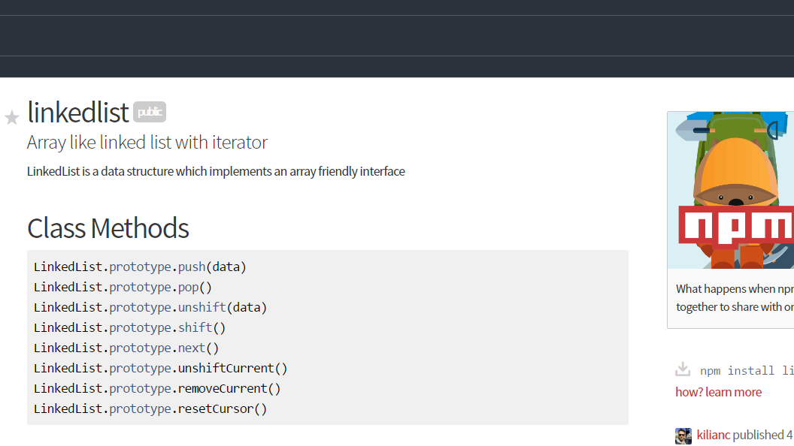
For the Lazy… (Myself included)
Notes:
<number>

Slide 117
Pulse Check…
Notes:
<number>

Slide 118
You Be the Teacher
To the person, next to you, explain each of the following concepts:
What is a data structure?
What does FIFO and LIFO stand for and mean?
What is a Stack?
What is a Queue?
What is a Linked List?
How are they each different from arrays?
What is one disadvantage of an array?
Most important question: Why are we doing all this again?
Notes:
<number>

Slide 119
Dictionaries (Maps)
Notes:
<number>

Slide 120
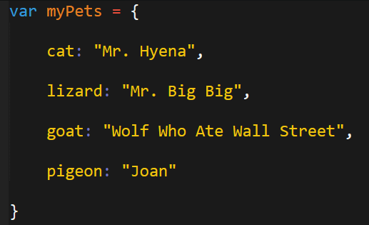
Dictionaries (Maps) **** (Actually Useful) ****
Dictionaries are an incredibly important data structure..
In fact, they address a common situation you’ve faced in this class.
How would you print all the pet names?
Notes:
<number>

Slide 121
Dictionaries (Maps) **** (Actually Useful) ****
Dictionaries are an incredibly important data structure..
In fact, they address a common situation you’ve faced in this class.
How would you print all the pet names?
Arrays don’t solve the problem either….
Notes:
<number>

Slide 122
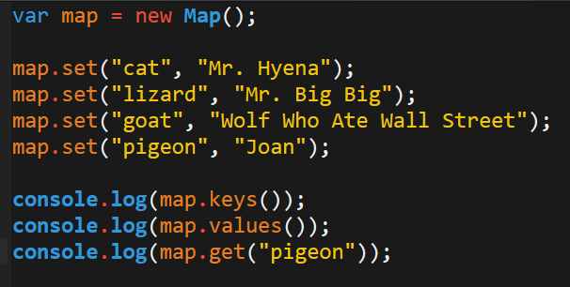
Dictionaries (Maps) **** (Actually Useful) ****
The solution is to use a dictionary (map).
In a way, dictionaries serve as a hybrid between objects and arrays.
They can be iterated over like arrays.
They have key, value pairs like objects.
Aaaand, it’s included in the latest version of Javascript (ES6).
BIG DEAL!
Notes:
<number>

Slide 123
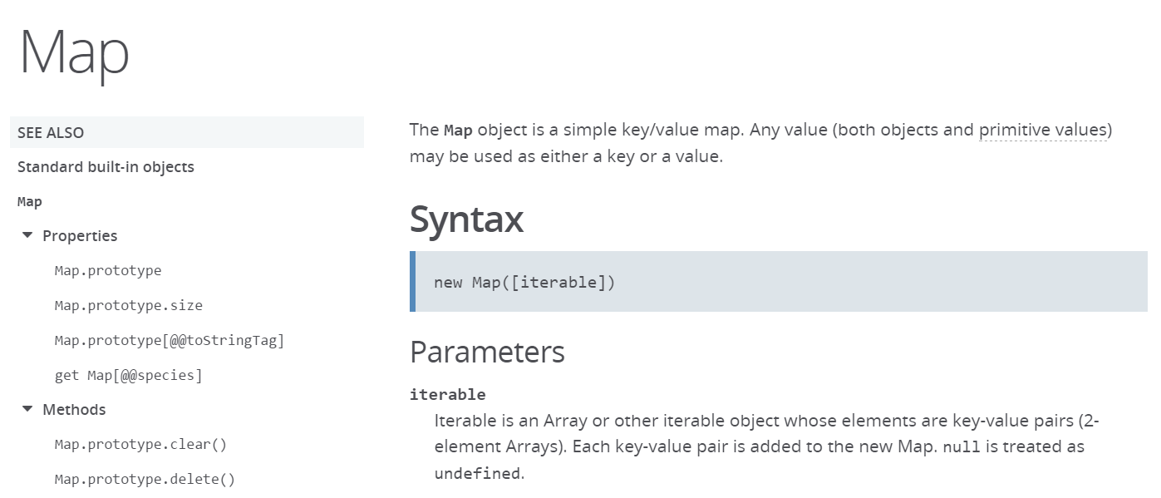
Dictionaries (Maps) **** (Actually Useful) ****
Learn more about Dictionaries (Maps) in JS:
https://developer.mozilla.org/en-US/docs/Web/JavaScript/Reference/Global_Objects/Map
Notes:
<number>

Slide 124
Trees
Notes:
<number>

Slide 125
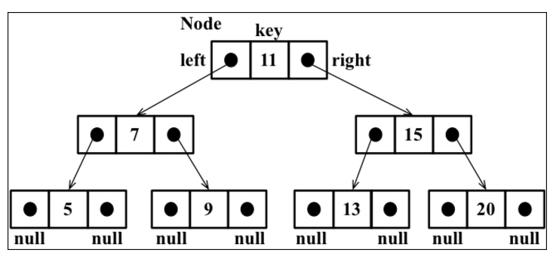
Trees
Trees are a favorite data structure for computer scientists
Trees are a non-sequential data structure made of parent-child relationships.
The top node of a tree is the root.
Trees have internal nodes and external nodes
Each node has ancestors and descendants
Kind of like a linkedlist
Notes:
<number>

Slide 126
Binary Trees
Binary Trees / Binary Search Trees (BST) are particularly useful
In a Binary Tree, nodes have two children at most. One on left and on right.
In a Binary Search Tree:
Left-hand side is lesser number; right-hand side is the larger
Paradigm makes it easy to insert, search, and delete from tree
Notes:
<number>

Slide 127
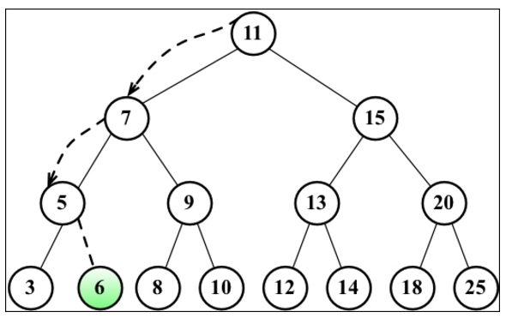
Binary Trees
Binary search trees are extremely efficient for searching.
Notes:
<number>

Slide 128
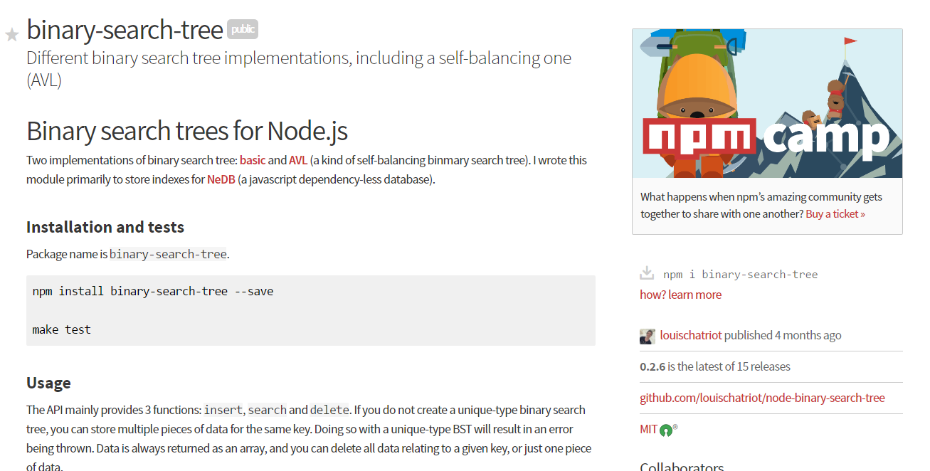
Binary Search Trees
https://www.npmjs.com/package/binary-search-tree
Notes:
<number>

Slide 129
Let’s Build this!
Take a few moments to build a binary search tree with those around you. As a suggestion, implement the following tree.
Then run a search for any number in the tree.
Notes:
<number>

Slide 130
Graphs
Notes:
<number>

Slide 131
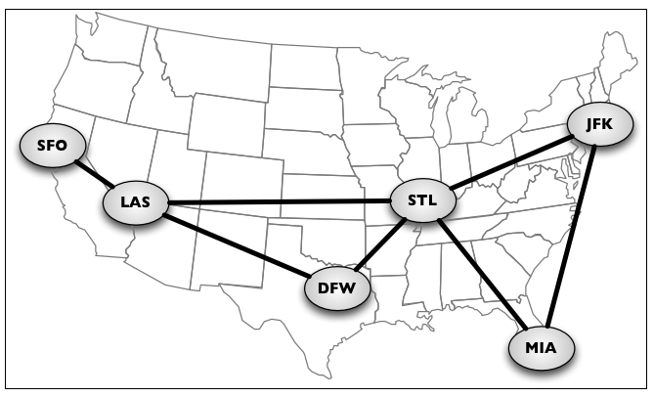
Graphs
Graphs are extremely powerful and increasingly common structures.
Graphs are abstract models of a network structure. They are a set of nodes (or vertices) connected by edges.
They are the essence of social networks and geographic maps.
The math gets ridiculously scary with this stuff…
Notes:
<number>

Slide 132
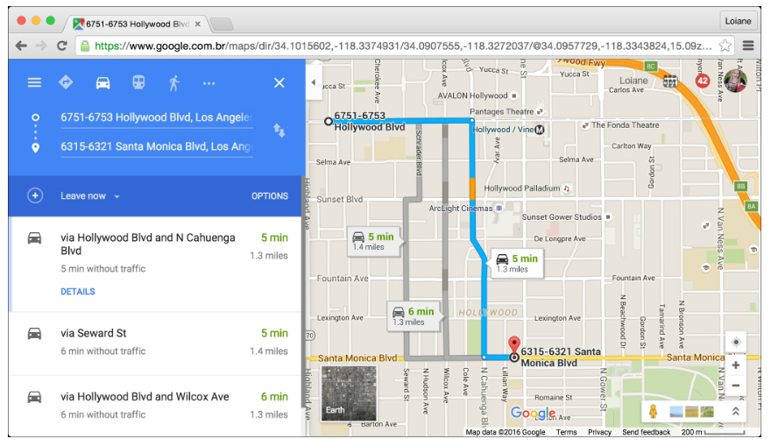
Graphs
But through graphs and “shortest-path” algorithms we can build map applications like the ones found on Google Maps
Notes:
<number>

Slide 133
Back to Projects!
Notes:
<number>

Slide 134
Questions
Notes:
<number>

